Slide 1







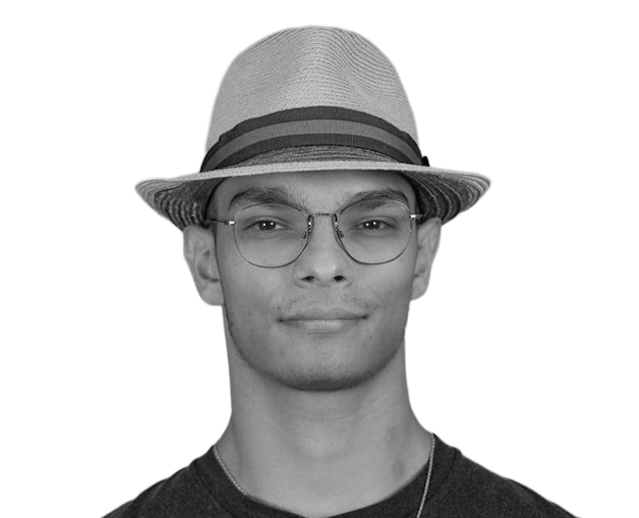



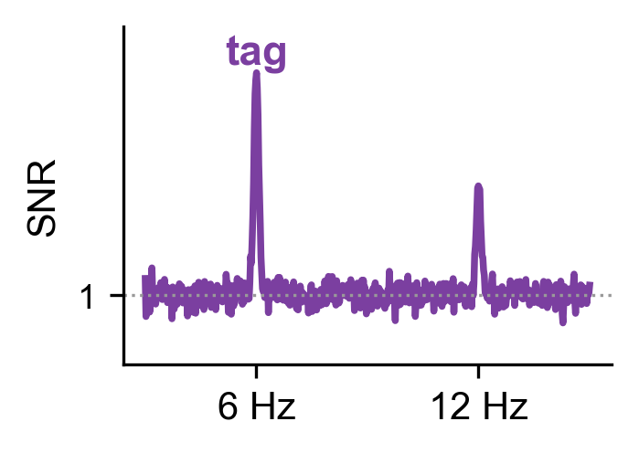
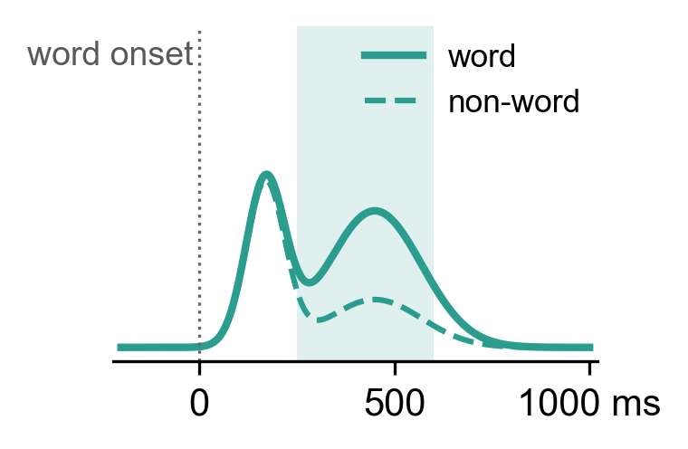
Characterizing word processing pathway using frequency tagging​
SNL 2026 · Geneva
Poster F52 · Session F · Fri 2 Oct, 2:45–4:45 pm
Background
Results
Visual Word Processing ¹⁻⁴
Frequency tagging ⁵⁻⁹
1 · Sensor space: the evoked response distinguishes words from(consonant string) nonwords (Aim 1)
(NON)WORD
Kishen Senziani ¹
1. The Stimulus
2. The Response
3. The Test
Vision
(~100 ms)
Letters/Words (~150-225 ms)
Meaning
(~250-600 ms)
'Cosmetic' flicker at a fixed rate
(6.00 or 7.06 Hz)
Visual cortex follows the flicker steady-state visual evoked field (SSVEF)
Can the frequency tag response map the visual word-processing pathway?
Word > Nonword cluster over left posterior and temporal sensors (N = 26, 84 sensors, p < .001), robust to blinks, saccades and artifacts (clean epochs: dz = 1.31, 20/21 subjects). Tag × Wordness: n.s.
(a) mean |t| in the cluster window (N = 26); (b) GFP of W − NW vs sign-flip noise (shaded: 95 %; dashed: FWER), exceeded at 628–764 ms; right: grand averages (N = 25) at 350 / 500 ms, ±25 ms; fixation baseline.
Visual area (V1) detects low level features.
Left ventral regions (vOT/VWFA) identify letter strings.
Left Temporal network extracts meaning.
Berk Gercek ¹
AIM 1
Observe the V1 → vOT → temporal lobe pathway in MEG sensor & source analyses
AIM 2
Does the frequency tag response (SSVEF) differ between words and consonant strings?
2 · Source space: Word > Nonword, maximal and sustained in anterior temporal cortex (Aim 1)
Ventral stream: no whole-epoch effect after FDR (FFC / VWFA dz = .34 / .45).
Temporal cortex: Word > Nonword in all 6 ROIs, maximal anteriorly (slope t(21) = 4.81, p < .001).
Anterior part sustained: present before word onset (consistent with a block-level state).
(a) log(Word / Nonword) over the word epoch, 95 % CI, * p_FDR < .05; (b) same effect (dz), fsaverage (V1 medial). N = 22, dSPM, equal counts, fixation baseline. Leakage, late vOT effect: QR.
Nina Kazanina ¹
^{Neurolingo lab}
Methods
1 STIMULUS (word or
nonword=consonant string)
2 TIMING
3 TASK
4 PARTICIPANTS
wary
240 Hz frame-locked, 2 blocks
behavioral catch-query
MEG 306 ch. 2 kHz + eye tracker
Structural T1 MRI
+
10 words
seen?
N = 30
19 female
¹ University of Geneva,
Faculty of Medicine, Department of Basic Neurosciences
age 24.9 ± 6.9 y (n = 30)
10 words = 28.33 s
2s 28.33s 1s + 4 x 2.83s
right-handed
native English speakers
F1 6.00 Hz
F2 7.06 Hz
1 word = 680 frames
17 cycles F1 | 20 cycles F2
YES
NO
normal or corrected vision
no neurological history
one tag per mini-block
3 · The frequency tagging response fails to distinguish words from nonwords (Aim 2)
PREPROCESSING all subjects · no ICA · MNE-BIDS-Pipeline (MNE-Python 1.10.2 | MNE-BIDS-Pipeline 1.10.1 | FreeSurfer 7.1.2)
Code · supplementary figures S1–S4 · cohort
github.com/Orion212-lab/snl2026-ft-word-pathway
Maxfilter
fine-cal + cross-talk, SSS order 8, movement comp.
Filter
notch 50/100Hz · band-pass 0.1–120Hz (evoked: 40Hz low-pass)
Resample
1 kHz
Epochs
mini-block 28.33s word −0.2–1s
Baseline
fixation (flicker-free rest)
Rejection
PTP mag 4000 fT · grad 4000 fT/cm → equal trials
Frequency tagging response (FT)
Power at the flicker rate (6 or 7.06 Hz, and harmonics) relative to the neighbouring frequencies (SNR). Follows the flicker, cycle after cycle.
Word vs Non-word: SNR difference.
Notes
Tags off by one FFT bin. The display ran ~0.5 % slow (photodiode: 5.965 / 7.024 Hz): read the SNR at the measured bin.
No gap between words. The pre-stimulus window contains the previous word: baseline during fixation instead.
References
Salmelin, R. 2007. Clinical Neurophysiology 118, no. 2: 237–254. https://doi.org/10.1016/j.clinph.2006.07.316.
Samoylov, A., Semenova, N., Myachykov, A., & Shtyrov, Y. (2025). Psychophysiology, 62(3), e70192. https://doi.org/10.1111/psyp.70192.
Thesen, T., McDonald, C. R., ...& Halgren, E. (2012). Nature Communications, 3, 1284. https://doi.org/10.1038/ncomms2220.
Cornelissen, P. L., Kringelbach, ... & Hansen, P. C. (2009). PLoS ONE, 4(4), e5359. https://doi.org/10.1371/journal.pone.0005359.
Norcia, A. M., Appelbaum, ... & Rossion, B. (2015). Journal of Vision, 15(6), 4. https://doi.org/10.1167/15.6.4.
Figueira, J. S. B., Kutlu, E., Scott, L. S., & Keil, A. (2022). Developmental Cognitive Neuroscience, 54, 101066.
Kabdebon, C., Fló, A., De Heering, A., & Aslin, R. (2022). NeuroImage, 254, 119150.
Lochy, A., Van Belle, G., & Rossion, B. (2015). Neuropsychologia, 66, 18-31. https://doi.org/10.1016/j.neuropsychologia.2014.11.007.
Wang, F., Kaneshiro, B., ... & McCandliss, B. D. (2021). Scientific reports, 11(1), 18229.
Tag (harmonics 1–4): occipital Nonwords > Words (dz = −.88, p < .001), following their larger letter area on screen; left-temporal Words ≈ Nonwords (|dz| < .5, TOST p = .03, BF01 = 4.2). Evoked 250–600 ms, the reverse: left-temporal W > NW (dz = 1.04, p < .001), occipital n.s.
N = 20 (sensor cohort), same epochs for both measures; per-word SNR, 2.83 s FFT, 3 neighbours/side; diamonds = mean ± 95 % CI; Tag × Wordness n.s.
Evoked response
Stage
V1
~100 ms
vOT / VWFA
~150–225 ms
Post. temporal ~250–600 ms
Ant. temporal sustained
MEG field averaged across words, time-locked to each word (every 2.83s).
Word vs Nonword: amplitude difference across the word epoch.
Evoked
✗ no Word ≠ Non-word
✗ 150–225 ms
late & fragile
✓ Word > Nonword
✓ Word > Nonword, sustained
Tag (FT)
✓ follows the visual input (occipital: consonant strings > words, visual complexity)
✗ left-temporal: Words ≈ Non-words (|dz| < .5, BF01 = 4.2)
Cohort 30 recorded; each panel states # participants entered in the analysis . Excluded: see the list via QR.
A priori Word vs Nonword at the tag and in the evoked cascade windows (80–130, 150–225, 250–600 ms), left-temporal sensors.
Aim 1 — partly: temporal stages replicated, vOT only late and fragile, latency order n.s.
Aim 2 — no: the tag indexes visual input, not wordness; the word-locked response does.

